Slide 1
OOP Operator & Expression

Slide 2
What is an Operator ?
An operator is a code element that performs an operation on one or more code elements that hold values.
Value elements include variables, constants, expressions.
Example- +,-,&,* etc.

Slide 3
What is an Expression ?
An expression is a series of value elements combined with operators which yields a new value.
The operators act on the value elements by performing calculations, comparisons, or other operations.
C=A+B

Slide 4
What is scope resolution operator ?
Scope resolution operator(::) is used to define a function outside a class or when we want to use a global variable but also has a local variable with same name.
Example- #include<iostream.h>
int a=30;
void main()
{
int a=15;
cout<<“the value of a=“<<a;
cout<<“the value of b=“<<b;
::a=20;
cout<<“the value of a=“<<a;
cout<<“the value of b=“<<b;
getch();
}

Slide 5
Addtion of two no using class
#include<iostream.h>
#include<conio.h>
Class sum
{
int a,b,c;
void input()
{
cout<<“ enter the two no”<<endl;
cin>>a>>b;

Slide 6
Continue……
C=a+b ;
Cout<<“ the sum is=“<<c<<endl;
}
};
Void main()
{
sum x; //declare a object//
x.input();
getch();
}

Slide 7
Type of Operator
There are five type of operator in VB as-
Arithmetic Operator.
Relational Operator.
Logical Operator.
Bitwise Operator.
Assignment Operator.

Slide 8
Arithmetic Operator
An arithmetic operator is a mathematical function that takes two operands and performs a calculation on them.
Operators that can be used within equations to perform a number of types of sequential calculation.

Slide 9
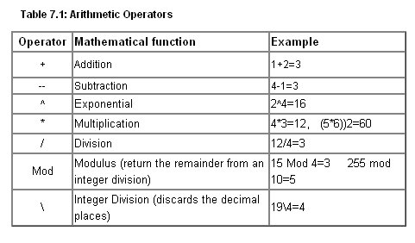
Continue…..

Slide 10
Relational Operator
Relational operator is a programming language construct or operator that tests or defines some kind of relation between two entities.
These include numerical equality (e.g., 5 = 5) and inequalities (e.g., 4 ≥ 3).

Slide 11
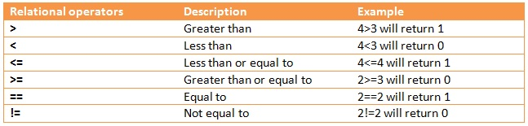
Continue…..

Slide 12
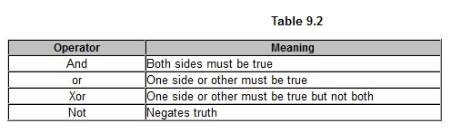
Logical Operator
Logical Operator is a symbol to check whether something is true or it is false.
This type of operation is performed using operators referred to as comparison operators.

Slide 13
Assignment Operator
Assignment operators store a value in the object designated by the left operand.
There are two kinds of assignment operations: simple assignment in which the value of the second operand is stored in the object specified by the first operand.
compound assignment in which an arithmetic, shift, or bitwise operation is performed prior to storing the result.
All assignment operators in the following table except the = operator are compound assignment operators.

Slide 14
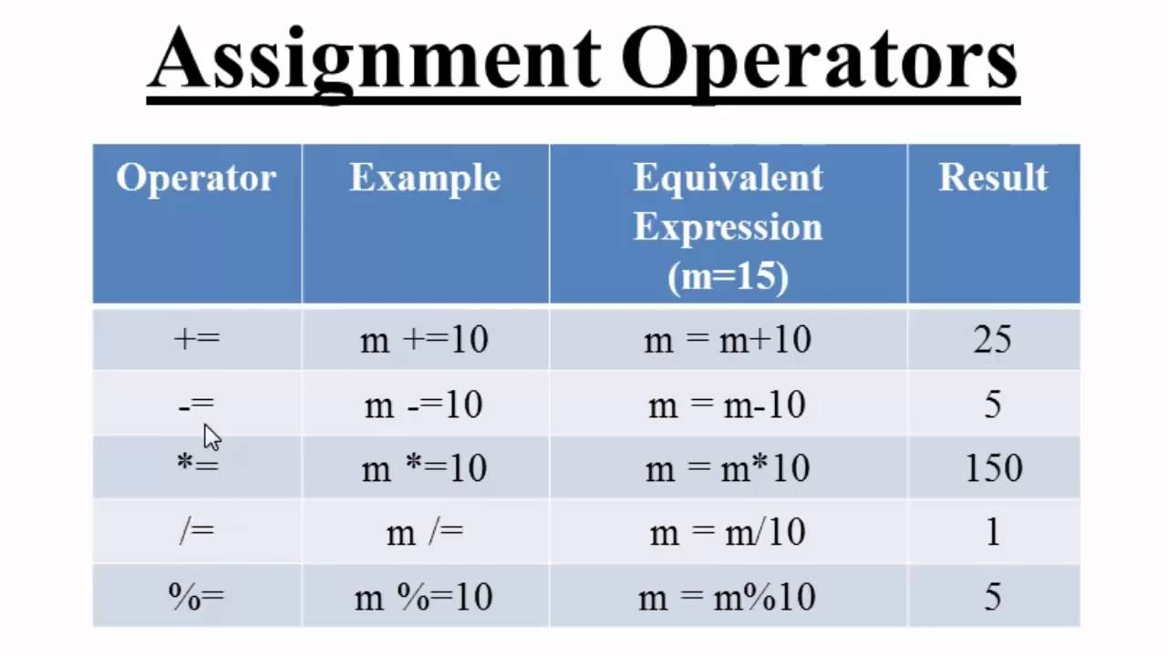
Continue…..

Slide 15
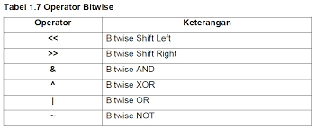
Bitwise Operators
A bitwise operator is an operator used to perform bitwise operations on bit patterns or binary numerals that involve the manipulation of individual bits.

Slide 16
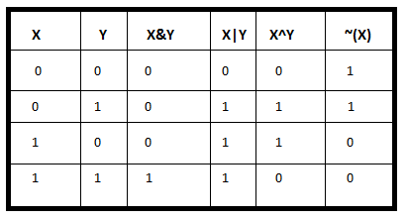
Continue…..

Slide 17
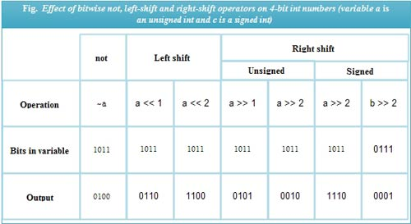
Continue……

Slide 18
THANK YOU

